Slide 1
Future Vision of Education
Megan Jackson
Post University

Slide 2
History Past and Present
Sayles School is a pre-K through 8th grade public school.
302 students currently enrolled
Fusion Paperboard closed in 2014-no other big businesses in area.
Spring 2018-Sayles School is $800,000 in debt.
Many administrative changes in the last 5 years.
Teachers lack support services, materials, resources, and training.

Slide 3
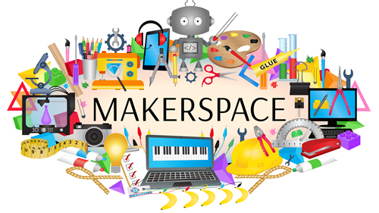
Horizon Reports Technology
Makerspace
“A great educational makerspace is within the reach of any educator possessing a powerful vision and a willingness to try new things” (Kurti, Kurti, Fleming, 2014).
Sayles School does not have the means to create a technological makerspace, but the students would benefit from a space in which they work collaboratively on a challenge.
Virtual Reality
“In the K-12 sector, VR is well-positioned as an educational tool, generating immersive environments for field trips, with simulation and research activities serving as a prime enabler of student centered, experimental, and collaborative learning” (Adams Becker, Freeman, Giesinger Hall, and Yuhnke, 2016).
Students would have the opportunity to experience the content they are learning without ever leaving the classroom.
The use of these technologies will not only benefit the students at Sayles School academically but socially as well.

Slide 4
Scenarios and Scanning
Scenarios
Scenarios are created as long term plans.
Research-based and data driven
“Scenarios are useful because they give us distance from the present, open up the future, and allow the creation of alternative futures” (Mietzner & Reger, 2005, p. 223).
Scanning
Scanning tools can be used to collect data
“Scanning the environment includes both observations and research-based data” (Sobrero, 2004, pars. 9).

Slide 5
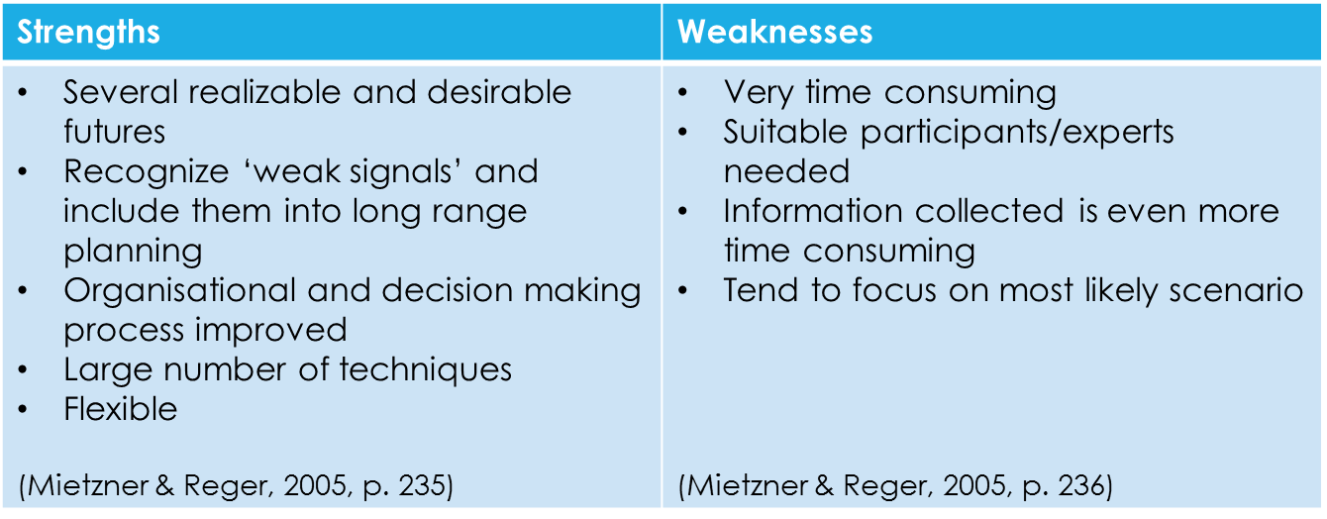
Scenarios and Scanning continued

Slide 6
Technology Trends
Gaming
In the video “Digital Media New Learners of the 21st Century” (2014) students translate the components of a fable into a game to demonstrate their comprehension (7:10).
There are many aspects of learning within this project that students will display their understanding of a fable (plot/setting, problem/solution, theme/moral) and their technological skill set as well (graphics, programming).
Students would take ownership of their learning because it is something enjoyable.
Effective Use of Technology
Marc Prensky explains how educators need to shift from a curriculum focused on reading, writing, math, science, and social studies to a focus on technology enhanced learning (Our Brains Extended, 2013).
. Yes, students need to be able to read, write, and solve math problems but with the use of different technologies students can demonstrate their learning through a creative process (gaming, makerspace, coding, or other project-based learning concept).

Slide 7


Economic/Public Policy Trends
Funding based on District’s Wealth
The Education Commission explains, “States use funding formulas to determine the base amount of funding that a district is entitled to for the upcoming school year – dividing the base funding amount between state education coffers and the local districts based on each district’s relative wealth” (2013, p. 2).
If funding education was made a priority all students would be given the same advantage of a quality education to prepare for their future.
Homework
Many schools across the country are realizing the negative effects of homework and assigning less (20 minutes of reading nightly) or assigning no homework at all.
Maureen Healy states, “No homework for kindergarten through fifth grade doesn’t erase learning, but helps students tolerate an often long day better and encourages them to pursue their unique interests after-school from reading and writing to taking photographs” (2017, pars 4).

Slide 8
Demographic Policy
Homeschooling
Many homeschoolers are learning via online resources, with the use of technology, creating, and experimenting.
Parents are finding a way to educate their children and meet their individual needs.
In the article Demographics of homeschoolers: A regional analysis within the national parameters it explains how the homeschooling population has grown from about 15,000 children in the 1970’s to over a million children in 2003 (Mackey, Reese, Mackey, 2011).
Immigration
Many times, students who come from other countries are mistaken as having a disability due to their culture, language, or other differences.
In his article Yates states, “Language diversity and language learning are often areas about which there is a lack of knowledge, erroneously held perception, prejudice, errors of classification, and of ineffective intervention” (2008, p 9).
Immigration continues to rise yearly, and schools need to be proactive and prepare for this student population beforehand.

Slide 9
Vision/Plan
One scenario for the next five years would be a student-centered approach to learning via the implementation of a makerspace, the use of gaming, and other technology for a blended classroom model.
In the article How do Educational Professionals Understand Creativity it reads, “It is indispensable that educators know the strategies to develop their creative potential and design learning scenarios that foster creativity in their students” (2012, p 47).
The educators at Sayles School need to be innovative in the way they teach by encouraging creativity, problem-solving, and questioning.
By implementing a student-centered environment for learning students will have a more personalized approach to education.

Slide 10
Plan for Change
To prepare this scenario Sayles School needs to adopt a new vision statement integrating a student-centered philosophy.
All the staff at Sayles School needs to be trained in strategies for blended classrooms, flipped classrooms, and the many different uses of technology.
Parents and families need to be educated on the benefits of makerspace, gaming, blended classrooms, and flipped classrooms and they should be encouraged to actively participate as much as possible.

Slide 11

Call for Action
The first steps needed to put this scenario into place would be professional development, funding, and support.
All teachers should receive training to develop an understanding of a student-centered approach to learning and to build confidence as they move forward.
Funding for this project is crucial for this scenario, whether it is funded through Donor’s Choose, grants, or other donations it needs to be a priority.
Sayles School needs to come together to support the best learning environment for their students and the future of education.

Slide 12
References
Adams Becker, S., Freeman, A., Giesinger Hall, C., Cummins, M., and Yunke, B., (2016). NMC/CoSN Horizon Repor: 2016 K-12 Edition. Austin, Texas: The New Media Consortium.
Digital Media New Leaders of the 21st Century. (2014). Retrieved from http://www.youtube.com/watch?v=jY8afG0vlsU
Education Commission. (August 2013). Who Pays the Tab for K-12 Education? How states allocate their share of education costs. The Progress of Education Reform, 14(4), 1-7.
Healy, Maureen. (2017). Research finds the effects of homework on elementary school students, and the results are surprising. Retrieved from https://www.lifehack.org/385878/research-finds-the-effects-of-homework-on-elementary-school-students-and-the-results-are-surprising
Journal of the Education of Young Scientists and Giftedness. (2012). How do Educational Professionals Understand Creativity? Vol. 2 Issue 2, p. 41-48, 8p.
Kurti, S., Kurti, D, and Fleming, L. (2014). Practical Implementation of an Educational Makerspace. Teacher Librarian. Dec. 2014, Vol 42 Issue 2, p20-24. 5p.

Slide 13
References
Mackey, B. W., Reese, K., & Macky, W. C. (2011). Demographics of homeschooler: A regional analysis within the national parameters. Education, 132(1), 133-140.
Mietzner, Dana and Reger, Guido. (2005). Advantages and disadvantages of scenario approaches for strategies foresight. Int. J. Technology Intelligence and Planning, Vol. 1 Issue 2, p. 220-239.
Prensky, Marc. (2013). Our Brains Extended. Educational Leadership, 70(6) 22-27.
Sobrero, Patricia. (2004). The steps for futuring. Journal of Extention, Vol. 42, Issue 3.
Yates, J. R. (2008). Demographic imperatives for education reform for culturally and linguistically diverse students. Multiple Voices for Ethnically Diverse Exceptional Learners, 11(1), 4-12.

